Slide 1

BUILDING A GUI FOR GAME DEVELOPMENT
BY JONATHAN EARL AND JASON HEROLD

Slide 2
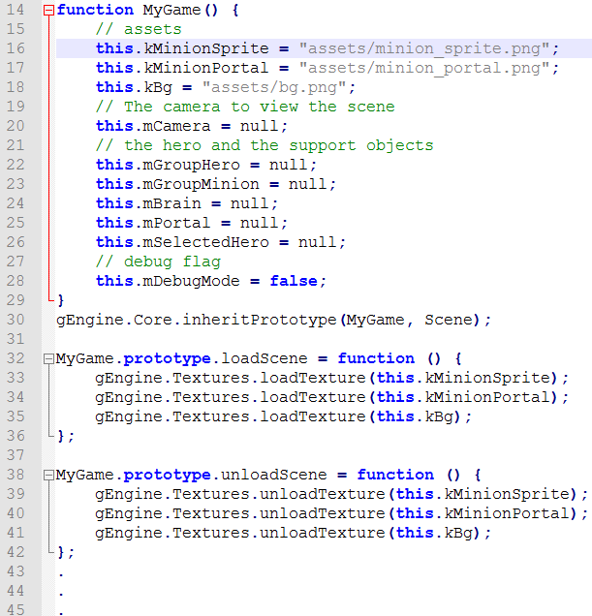
BACKGROUND: GTCS Game Engine
GTCS game engine built by students
Hand code everything
Slow
Hard to understand

Slide 3
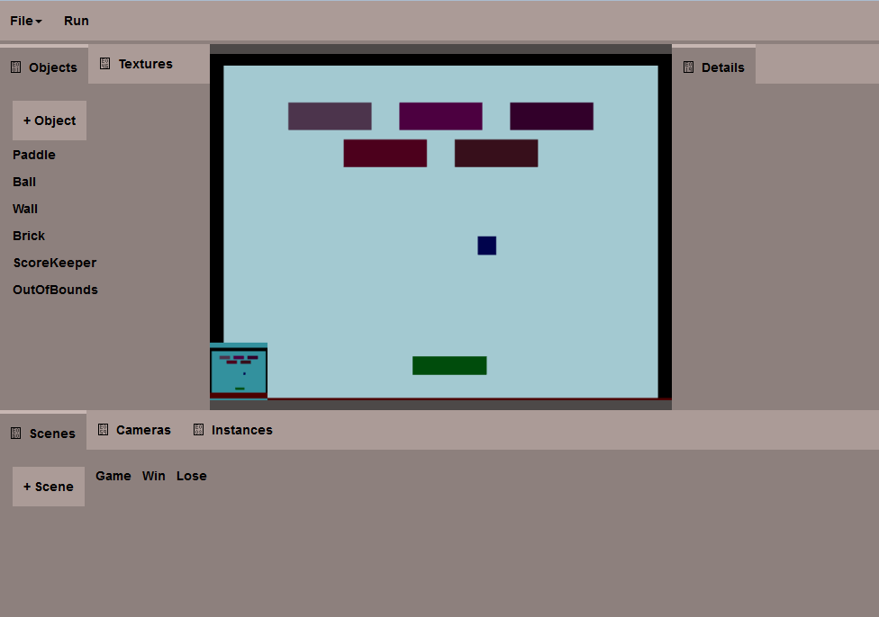
BACKGROUND: Prototype
Prototype built by Dexter Hu
Proof of concept
Basic engine functionality in place
Some issues:
Hard-coded user interface
Code not well abstracted
Missing functionality
https://students.washington.edu/dexterhu/may30/FinalGame/public_html/

Slide 4
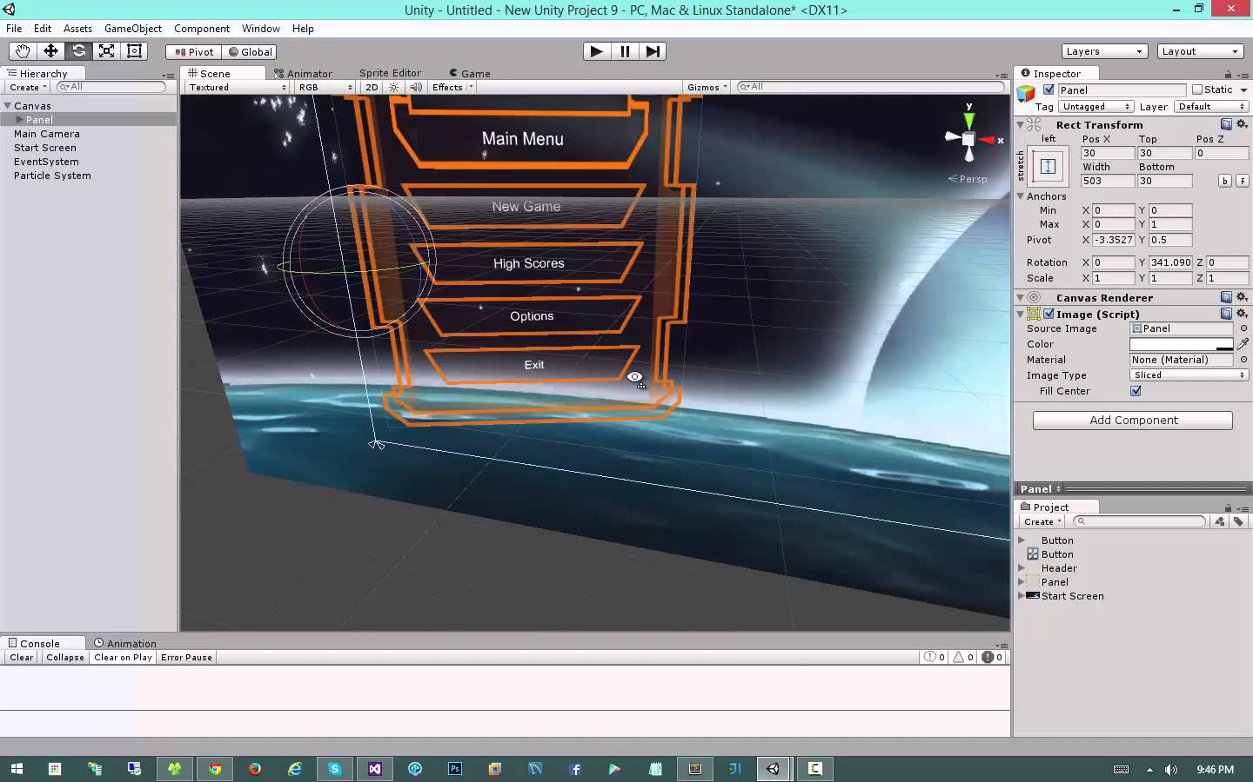
BACKGROUND: Next Step
Build a web-based Unity-like GUI to work with the engine
34% of top 1000 free mobile games are Made with Unity

Slide 5
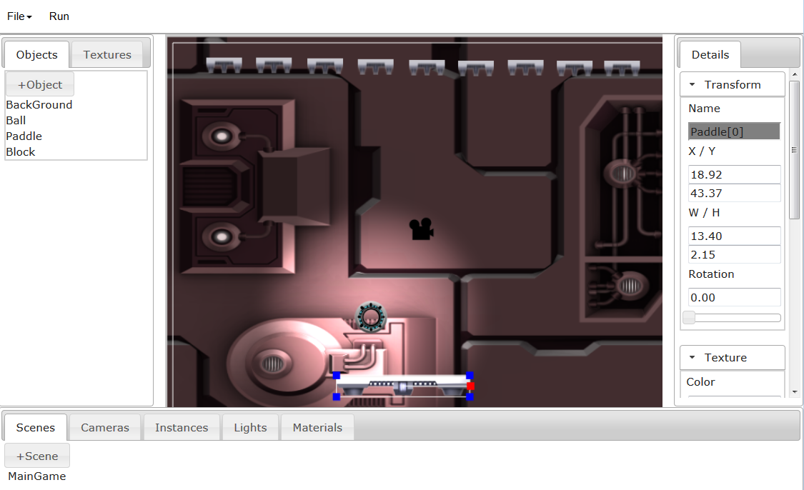
OUR PROJECT
Rework the prototype to fix the issues
Add additional functionality
Engine functionality
Direct manipulation
Customizable GUI
No emphasis on UX
http://students.washington.edu/metablue/

Slide 6
GOALS: GUI FRAMEWORK
Increase GUI customizability
Create a reusable content framework
Easy to modify to fit different objects
Modular

Slide 7
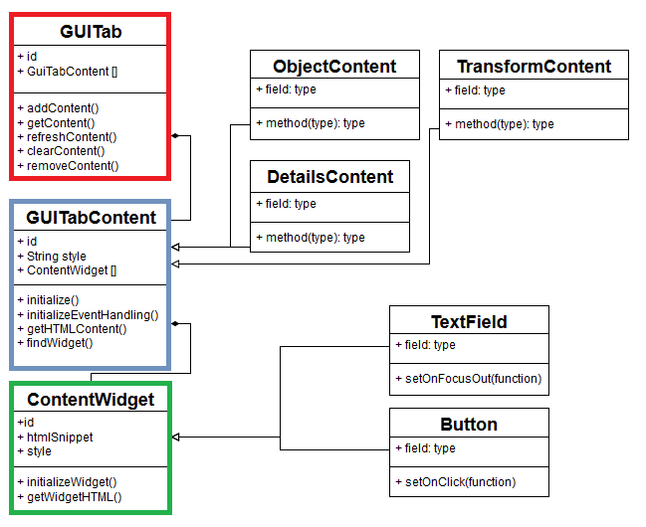
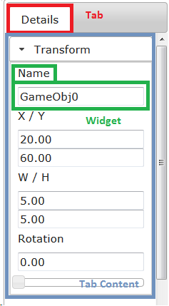
SOLUTION: GUI CONTENT FRAMEWORK
GUITab -> GUITabContent -> ContentWidget
Allows for simple editing of content via extending GUITabContent
Easy to add new widgets by extending ContentWidget

Slide 8
SOLUTION: USER CUSTOMIZATION
Functionality added:
Resize panels
Drag tabs into other panels
Drag tabs out of panel to create a floating window
Reorder tabs within a panel

Slide 9
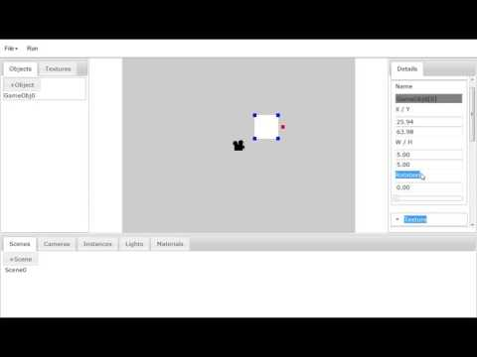
RESULT

Slide 10
GOALS: GUI BACKEND
Reuse Prototype solutions
Manage complexity
Code reorganization / Divide code into meaningful chunks
Singleton
Extend functionality
Camera
Texture
Lighting/Illumination

Slide 11
SOLUTION: GUI BACKEND
Reuse prototype solutions
GameObjects
Editor
Cameras
Main Files
View - 1700 lines
ClientScene
GameCore - 500 lines

Slide 12
SOLUTION: GUI BACKEND
Prototype files
Break up large files
Reuse code!
Hard to navigate
Dependencies are hidden
Build Into GUI Base
Singleton
Easy to find relevant functions
Easy to add-on functionality
GameCore
View
Break Up and Rebuild!
GuiBase
Our Gui Core
Reorganize and Refactor
Save/Load
Editor
Instances
GameObjects
Cameras
Scenes
Components

Slide 13
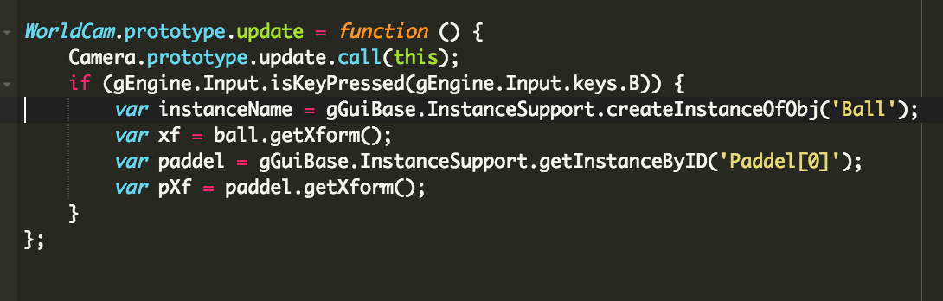
RESULT
Most Time Spent on Reorganization and Refactoring
4 weeks
Easy To Extend Functionality
1 week:
Camera / Lighting / Illuminate Renderable
Easy to find relevant functions
Needs UX refinement
IE Creating Game Objects is awkward

Slide 14
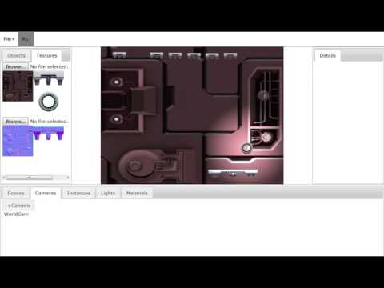
RESULT

Slide 15
GOALS: DIRECT MANIPULATION
Previous interactions not user friendly
Add more intuitive interactions
Make the common changes quickly
Simple interface

Slide 16
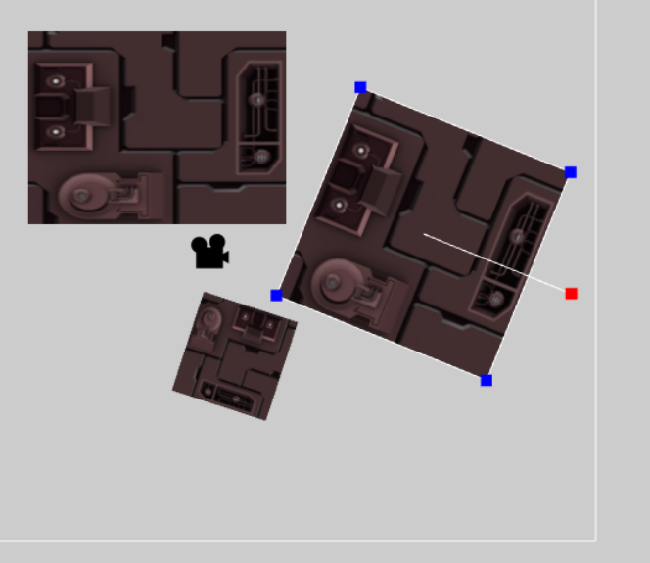
SOLUTION: DIRECT MANIPULATION
GameObjects
Scaling
Translating
Rotation

Slide 17
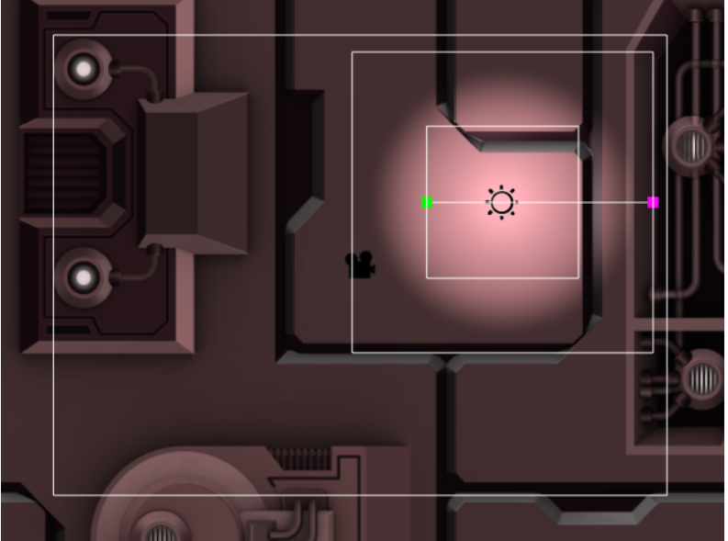
SOLUTION: DIRECT MANIPULATION
Light Objects
Translate (For point lights and spotlights)
Adjust inner and outer radius (For spotlights)
Adjust near and far radius (For point lights and spotlights)

Slide 18
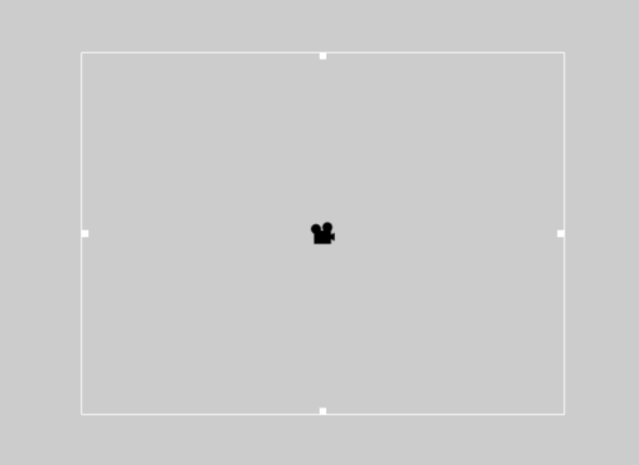
SOLUTION: DIRECT MANIPULATION
Camera Objects
Translate
Scaling

Slide 19
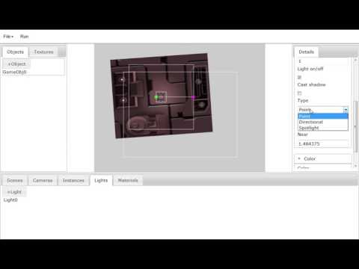
RESULT

Slide 20
CONCLUSIONS
What went well:
Tab content system -- will make things easier in the long run
JQuery UI integration
What could have been done differently:
Direct manipulation structure/issues
API for editing not clear
What we learned:
Javascript/JQuery/JQuery UI
GUI building

Slide 21
Conclusions (Next steps)
Fix documented bugs
User experience design and user testing
General refactoring
Add additional engine functionality (Particle system, physics)
Make scripts applicable to all objects (GameObjects, Lights, Cameras…)
Create a version of the GUI to run games

Slide 22
QUESTIONS?

